Slide 1
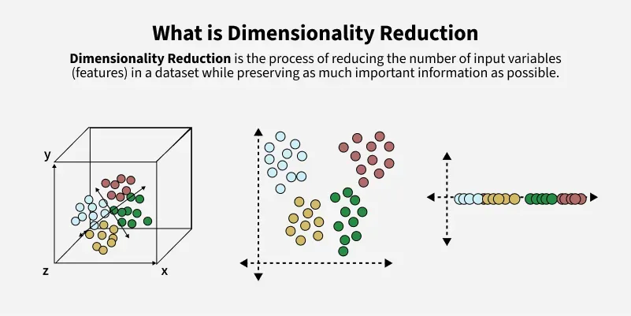
Dimensionality Reduction
Simplifying Complexity without Losing the Story
Instructor: Zaryab Ahmad Khan

Slide 2
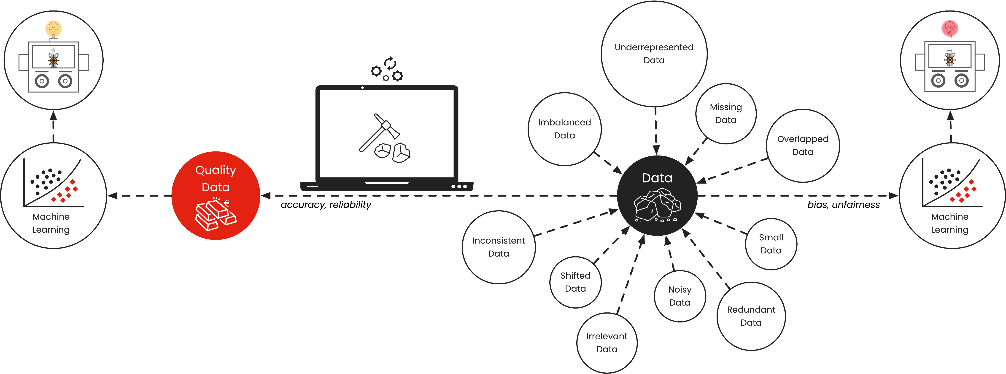
The Problem of Too Much Data
The "Curse of Dimensionality": Having 100 columns of data isn't always better.
Performance Hit: Too many features can confuse an algorithm, increase training time, and actually make predictions worse by adding noise.
Analogy: Trying to recognize a friend by looking at 1,000 microscopic skin cells (too much detail) vs. just looking at their face (the important "components").

Slide 3
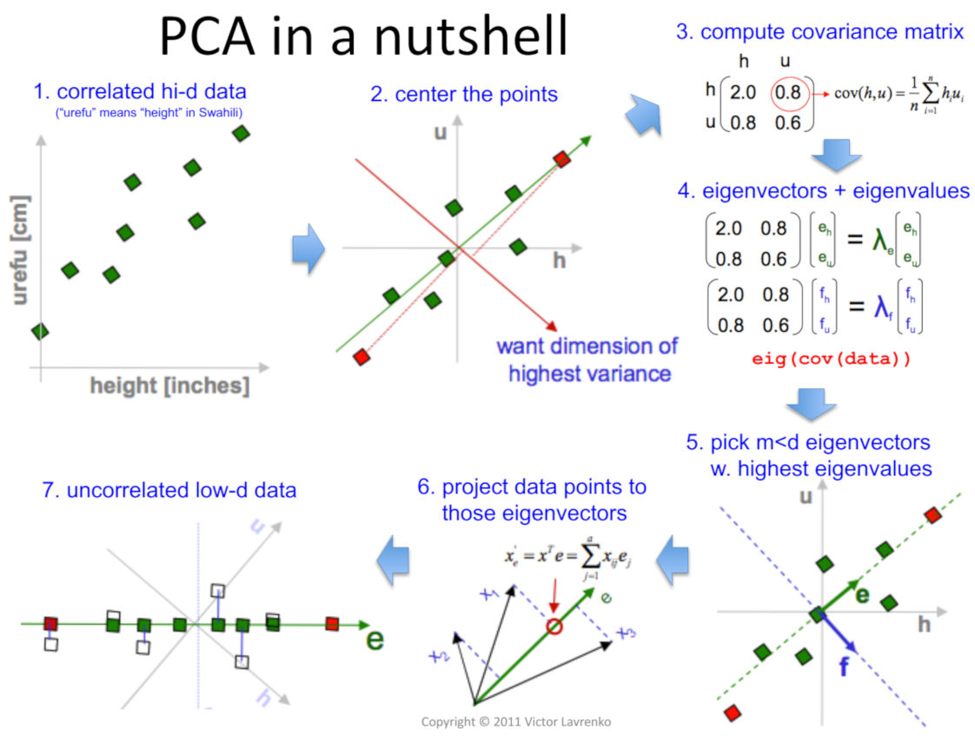
Principal Component Analysis (PCA)
Definition: A mathematical technique that safely compresses high-dimensional data (e.g., 20 columns) into just a few "Principal Components" (e.g., 3 columns).
Goal: Keep the most important mathematical patterns and "variance" intact while throwing away the redundant fluff.

Slide 4
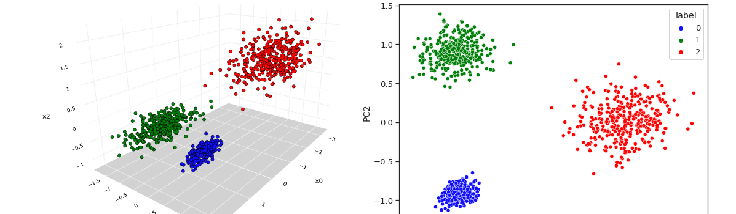
Using PCA for Visualization
The Human Limit: Humans can visualize 2D (a flat chart) or 3D (a cube), but we cannot "see" 50 dimensions.
The Solution: Use PCA to shrink complex data down to 2 dimensions so it can be plotted on a standard X/Y scatter chart.
Benefit: This allows us to visually confirm if our data naturally forms clusters or groups.

